Slide 1
Java Regex
The Java Regex or Regular Expression is an API to define pattern for searching or manipulating strings.
Java Regex is widely used to define constraint on strings such as password and email validation.
Java Regex API provides 1 interface and 3 classes in java.util.regex package.
java.util.regex provides classes for matching character sequences against patterns specified by regular expressions.
matching
Character sequences
patterns

Slide 2
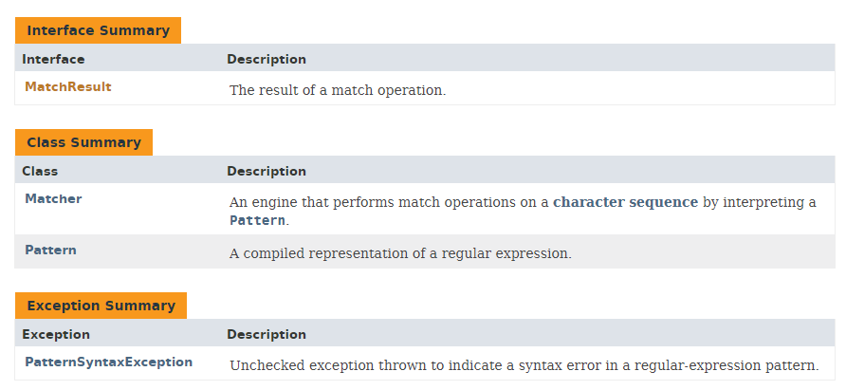
Java Regex

Slide 3
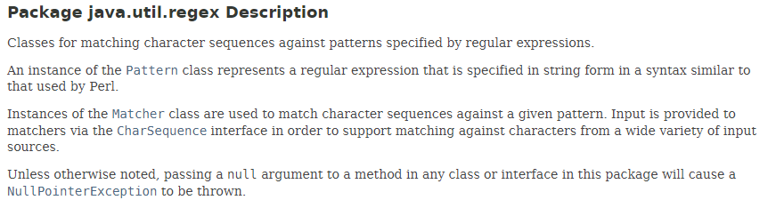
Java Regex

Slide 4
Java Regex
https://docs.oracle.com/javase/8/docs/api/index.html?java/util/regex/package-summary.html

